Slide 1
EMTH403
Mathematical Foundation for Computer Science

Slide 2
Lecture Outcomes
understand how to represent relations using digraphs
understand what is a Hasse Diagraph/Diagram.

Slide 3
Application – Job Scheduling
Task 4
6 hours
Task 6
1 hour
Task 2
6 hours
Task 1
7 hours
Task 5
3 hours
Task 3
3 hours
Task 9
5 hour
Task 8
2 hour
Task 7
1 hour

Slide 4
Assemble an Automobile
Build Frame
Install engine, power train components, gas tank.
Install brakes, wheels, tires.
Install dashboard, floor, seats.
Install electrical lines.
Install gas lines.
Attach body panels to frame
Paint body.

Slide 5
Prerequisites
Task | Immediately Preceding Tasks | Time Needed to Perform Task
1 2 3 4 5 6 7 8 9 | 1 1 2 2, 3 4 2, 3 4, 5 6, 7, 8 | 7 hours 6 hours 3 hours 6 hours 3 hours 1 hour 1 hour 2 hours 5 hours

Slide 6
Maximal and Minimal Elements
An element of a poset is called maximal if it is not less than any element of the poset.
That is, a is maximal in the poset (S, ) if there is no
b ∈ S such that a ≺ b.

Slide 7
Maximal and Minimal Elements
Similarly, an element of a poset is called minimal if it is not greater than any element of the poset.
That is, a is minimal if there is no element b ∈ S such that b ≺ a.

Slide 8
Maximal and Minimal Elements
Maximal and minimal elements are easy to spot using a Hasse diagram. They are the “top” and “bottom” elements in the diagram.

Slide 9
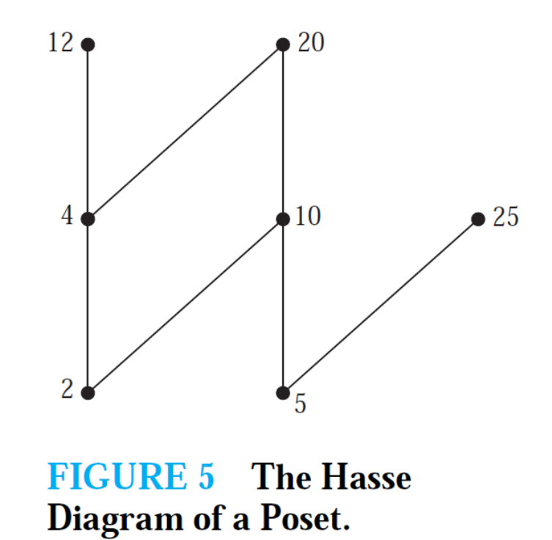
Maximal and Minimal Elements – Example 1
Which elements of the poset ({2, 4, 5, 10, 12, 20, 25}, |) are maximal, and which are minimal?
The Hasse diagram in Figure above for this poset shows that the maximal elements are 12, 20, and 25, and the minimal elements are 2 and 5.

Slide 10
Maximal and Minimal Elements
Find the maximal elements. for the poset ({3, 5, 9, 15,24, 45}, |).
Maximal elements are those that do not divide any other elements of the set.
In this case 24 and 45 are the only numbers that meet that requirement.
45
24
9
15
3
5

Slide 11
Maximal and Minimal Elements
Find the minimal elements for the poset ({3, 5, 9, 15,24, 45}, |).
Minimal elements are those that are not divisible by any other elements of the set.
In this case 3 and 5 are the only numbers that meet that requirement.
45
24
9
15
3
5

Slide 12
Greatest and the least Elements
Sometimes there is an element in a poset that is greater than every other element.
Such an element is called the greatest element. That is, a is the greatest element of the poset (S, ≪) if b a for all b ∈ S. The greatest element is unique when it exists.

Slide 13
Greatest and the least Elements
Likewise, an element is called the least element if it is less than all the other elements in the poset.
That is, a is the least element of (S, ) if a b for all b ∈ S. The least element is unique when it exists.

Slide 14
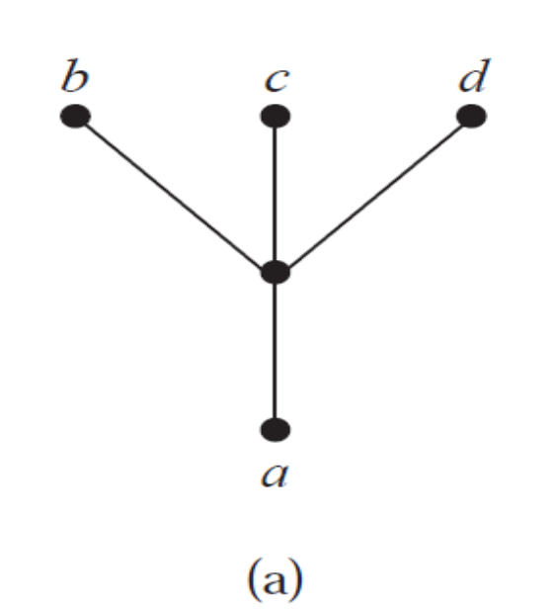
Greatest and the least Elements – Example 1
Determine whether the poset represented by the Hasse diagram have a greatest element and a least element.
The least element of the poset with Hasse diagram is a.
This poset has no greatest element.

Slide 15
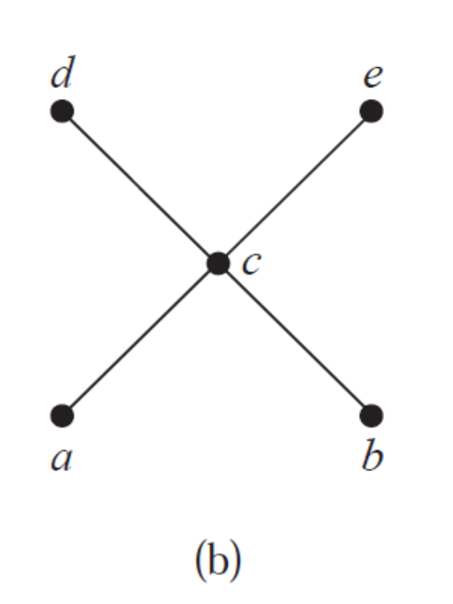
Greatest and the least Elements – Example 2
Determine whether the poset represented by the Hasse diagram have a greatest element and a least element.
The poset with Hasse diagram has neither a least nor a greatest element.

Slide 16
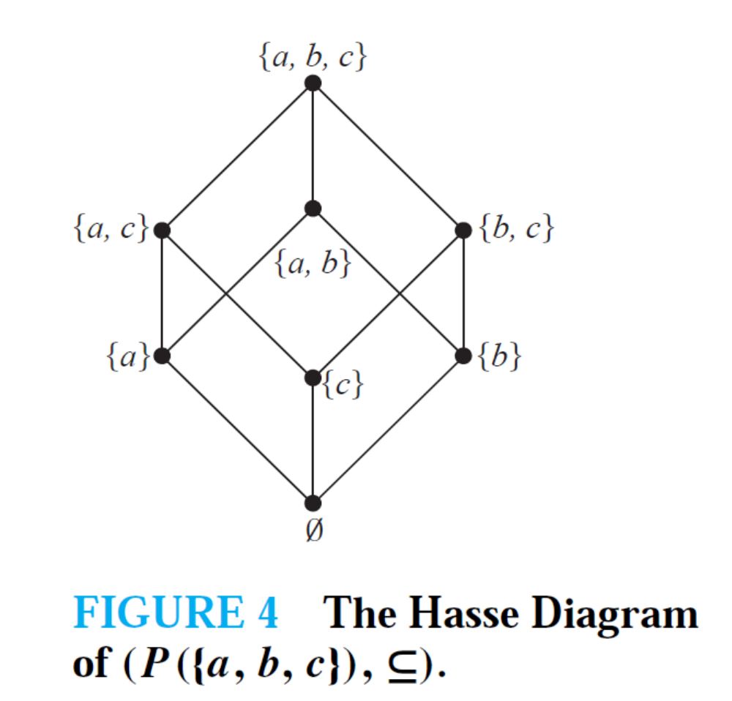
Greatest and the least Elements – Example 2
Let S be a set. Determine whether there is a greatest element and a least element in the poset (P (S),⊆).
The least element is the empty set, because ∅ ⊆ T for any subset T of S.
The set S is the greatest element in this poset, because T ⊆ S whenever T is a subset of S.

Slide 17
Upper Bound and Lower Bound
Sometimes it is possible to find an element that is greater than or equal to all the elements in a subset A of a poset (S,<< ).
If u is an element of S such that a u for all elements a ∈ A, then u is called an upper bound of A.

Slide 18
Upper Bound and Lower Bound
Likewise, there may be an element less than or equal to all the elements in A.
If l is an element of S such that l a for all elements a ∈ A, then l is called a lower bound of A.

Slide 19
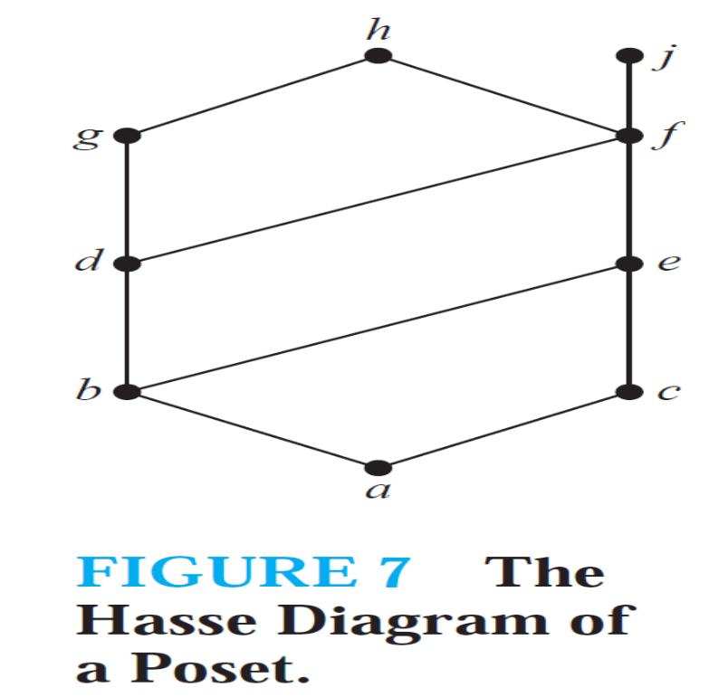
Upper Bound and Lower Bound
Find the lower and upper bounds of the subsets {a, b, c} in the poset with the Hasse diagram shown in Figure.
The upper bounds of {a, b, c} are e, f, j, and h, and its only lower bound is a.

Slide 20
Upper Bound and Lower Bound
Find the lower and upper bounds of the subsets {a, c, d, f } in the poset with the Hasse diagram shown in Figure.
The upper bounds of {a, c, d, f } are f , h, and j , and its lower bound is a.

